Slide 1

Attention isn’t all you need！
Mamba can get higher speed.
By
Weitao Xiong
Advisor:
Prof. Hongfei Xue

Slide 2

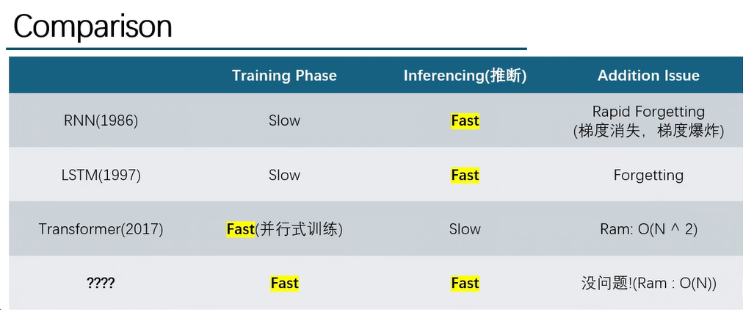
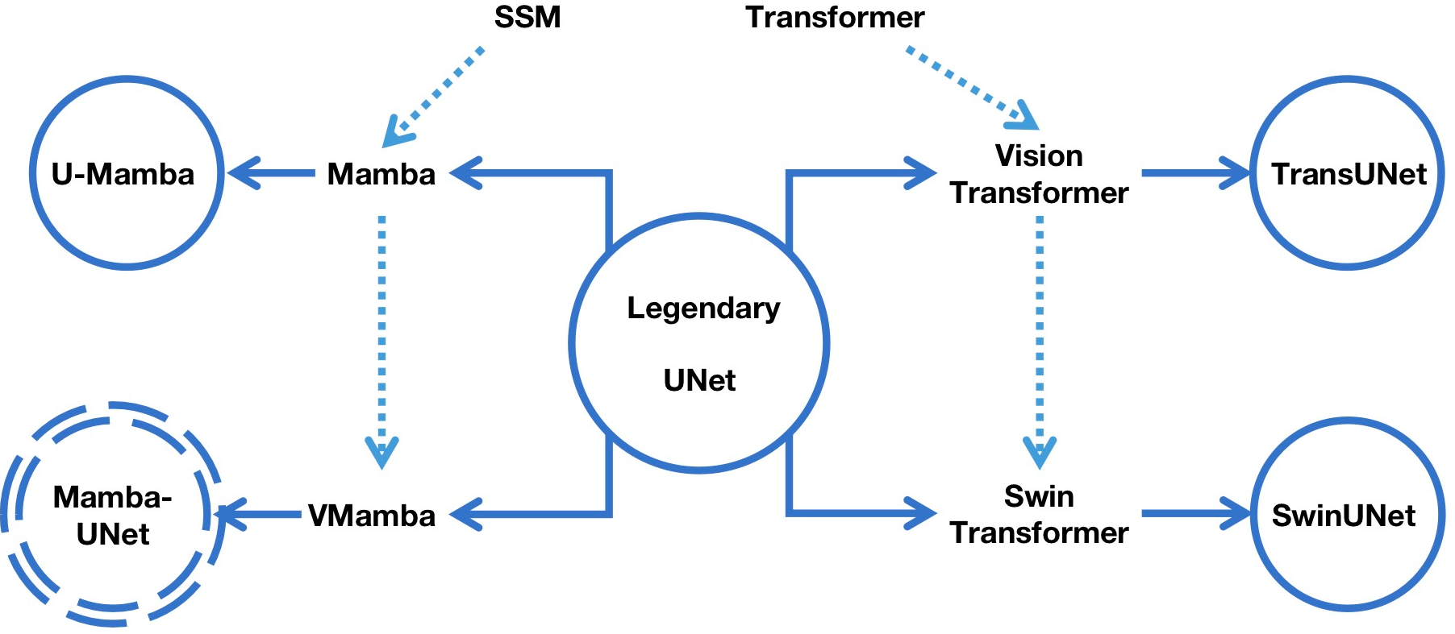
Why we need a new model?
Mamba enjoys fast inference (5× higher throughput than Transformers) and linear scaling in sequence length, and its performance improves on real data up to million-length sequences.
U-Mamba (2024.1.9):
Image Segmentation
Vision Mamba (2024.1.17):
Classification
Mamba Unet(2024.2.7):
Semantic Segamentation
Mamba
(2023.12.1)

Slide 3
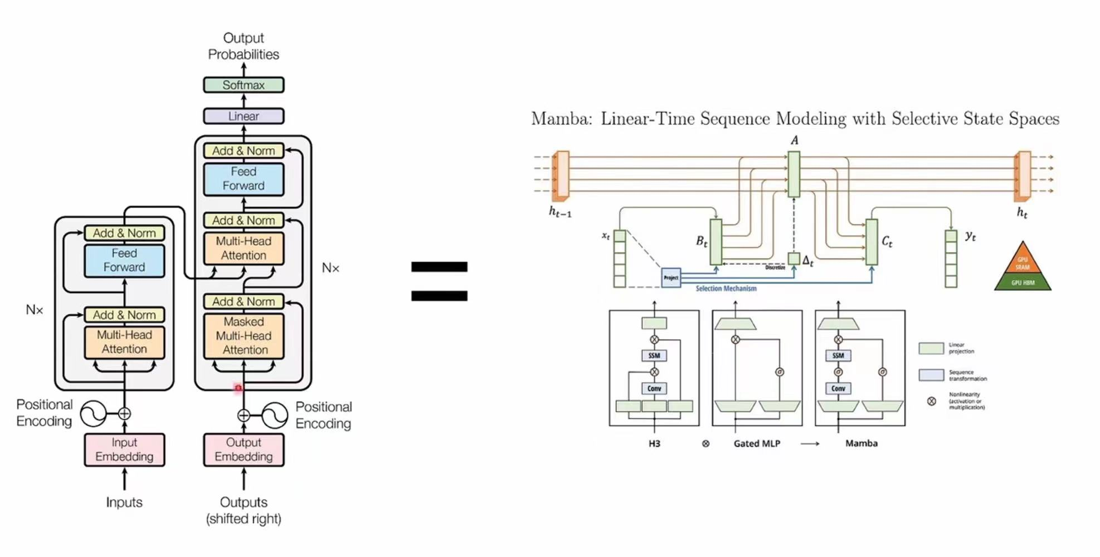
If you use Transformer Block in your model, you can just replace it with Mamba Block.

Slide 4


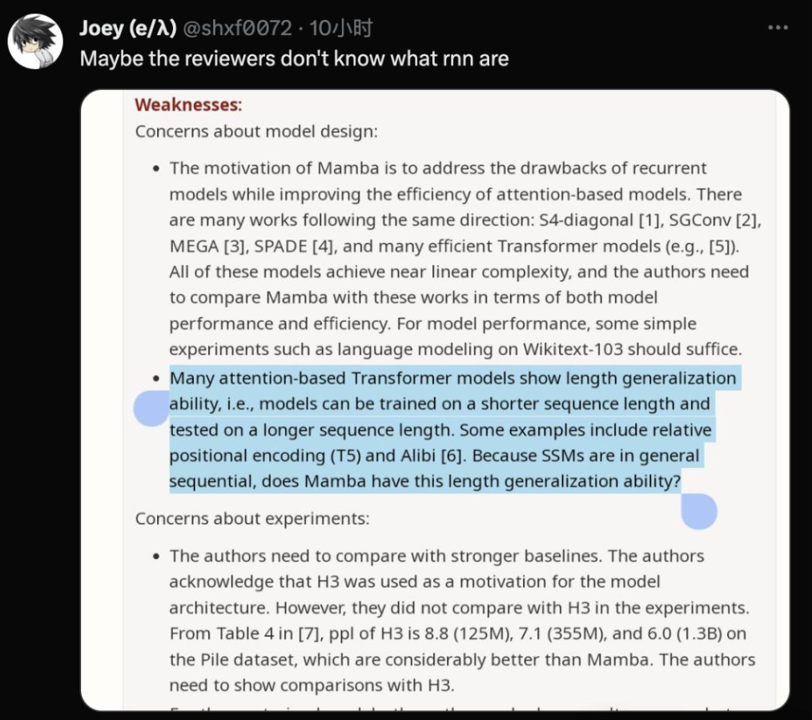
Some Jokes
However, Mamba is rejected by ICLR 2024.
Rate is 8/8/6/3.

Slide 5
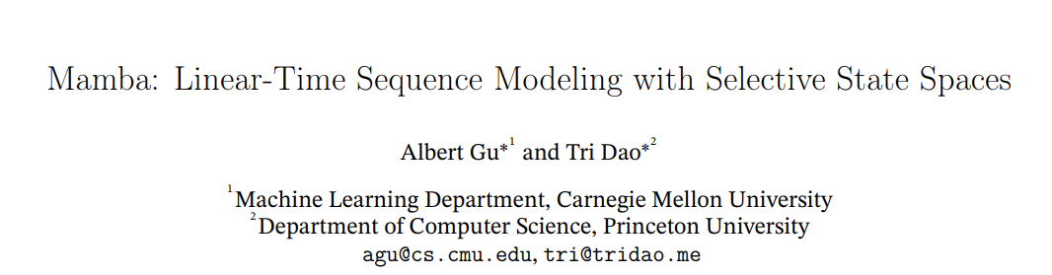

What is Mamba?
Three keywords:
Linear-Time Sequence Model
State Space Model (SSM)
Selective
Previous work
New Contribution

Slide 6
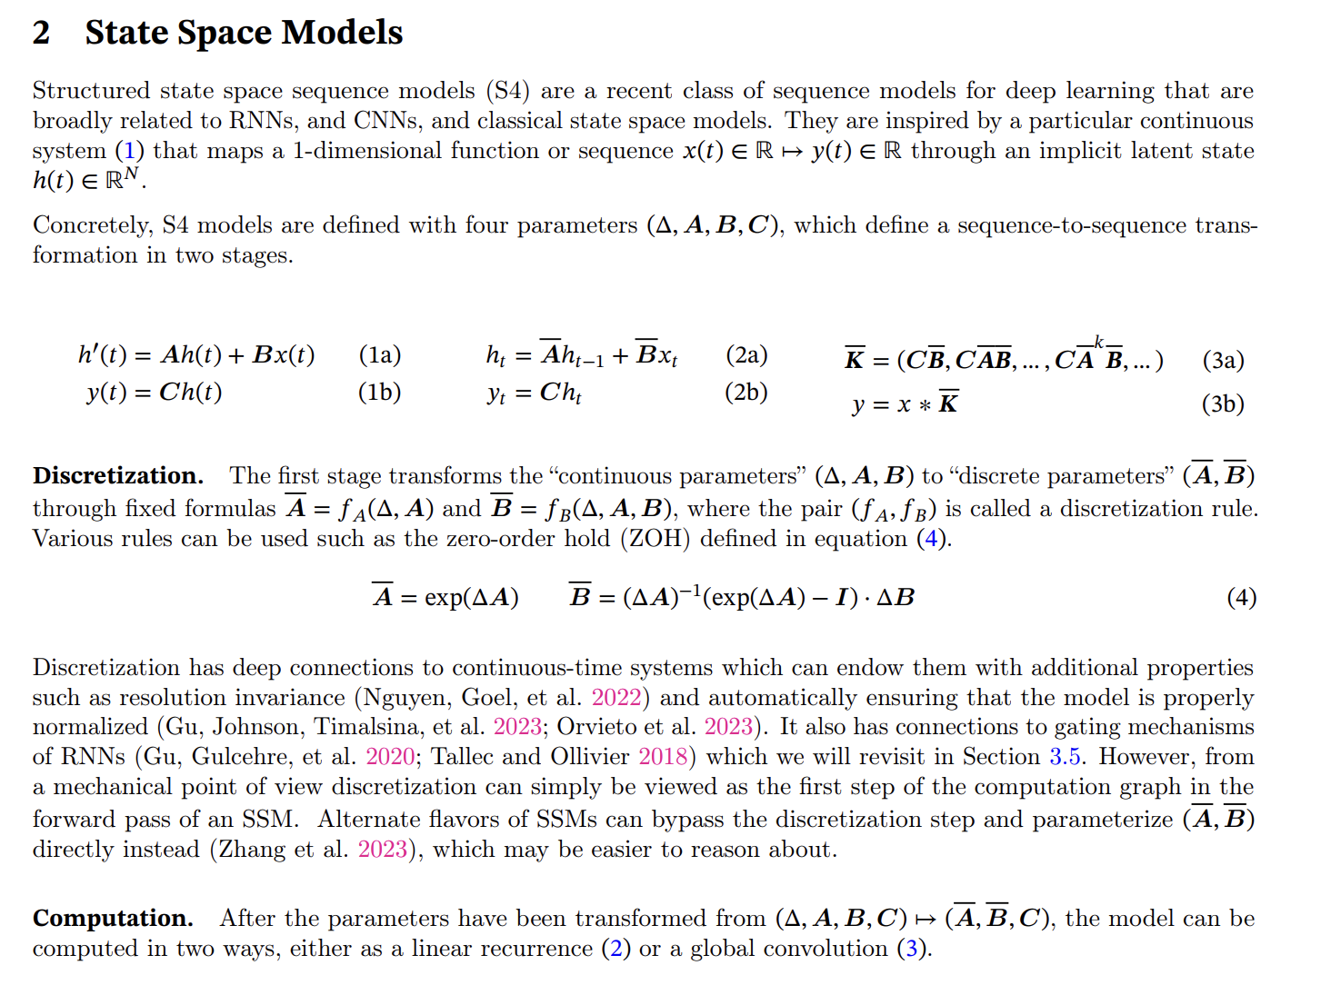
These are all core equations, and we will first focus on his previous work --- State Space Model, HiPPO, and S4 Model.

Slide 7
State Space Model

Slide 8
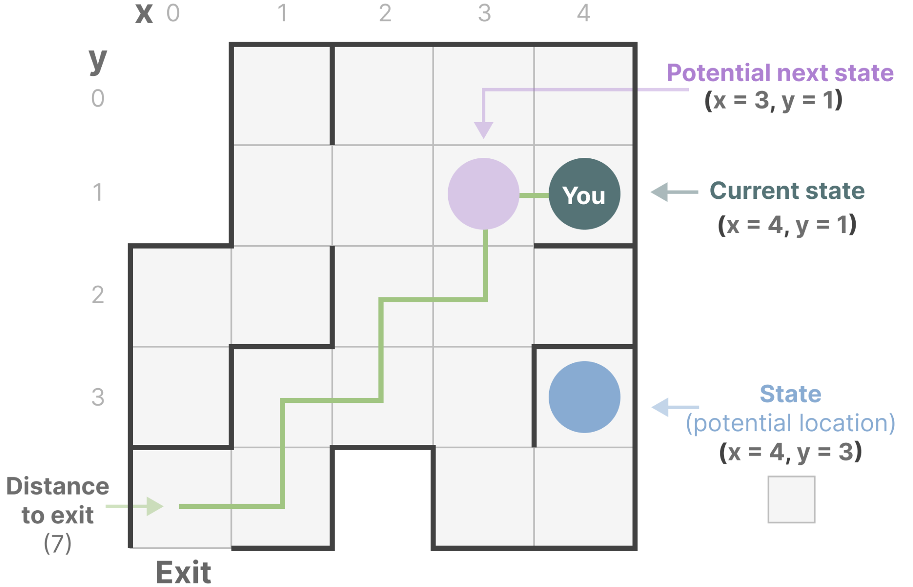
What is State Space?
State Space is a discrete space representing the set of all possible configurations of a "system".
Example:
“State Space” is the map of all possible locations (states). Each point represents a unique position in the maze with specific details, like how far you are from the exit.
“State Space Representation” is a simplified description of this map. It shows:
where you are (current state),
where you can go next (possible future states)
what changes take you to the next state (going right or left).

Slide 9
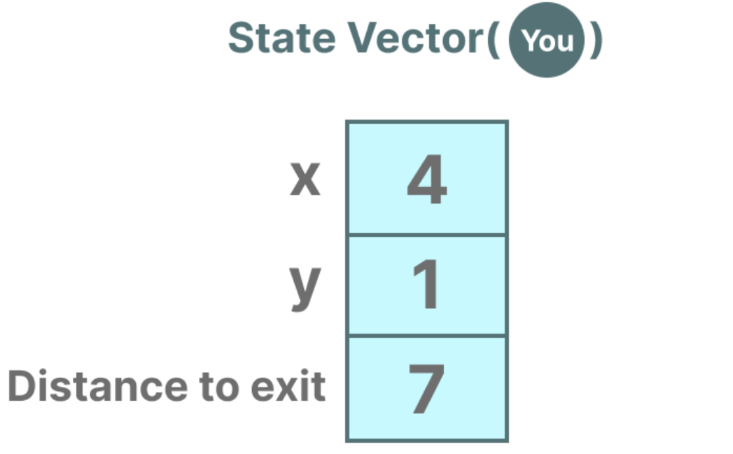
It is similar to embeddings or vectors in language models, both of them frequently used to describe the “state” of an input sequence.
In terms of neural networks, the “state” of a system is typically its hidden state and in the context of Large Language Models, one of the most important aspects of generating a new token.

Slide 10
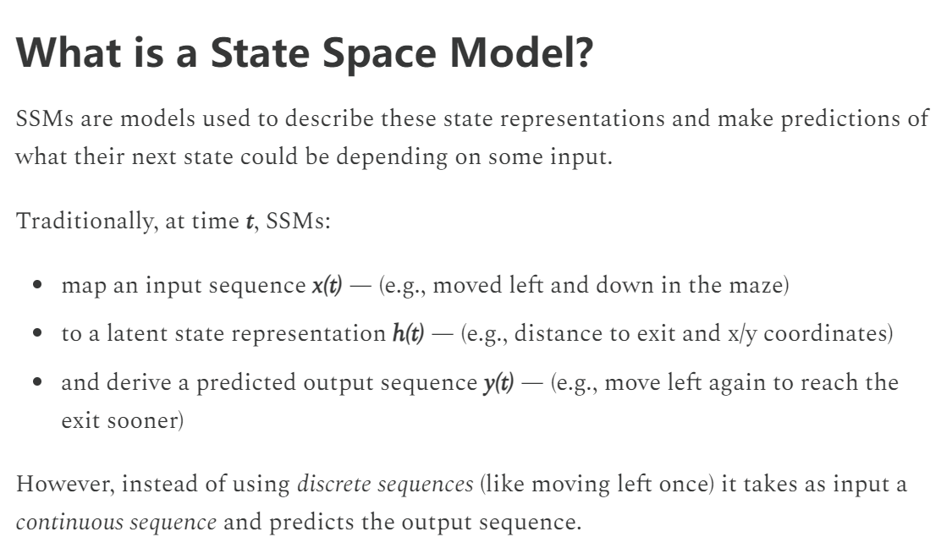
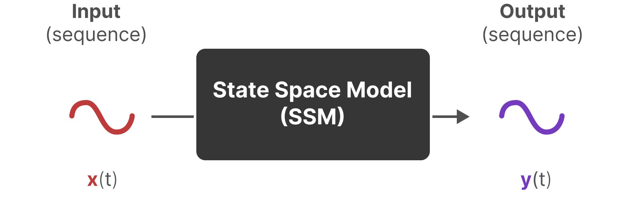
State Space Model

Slide 11
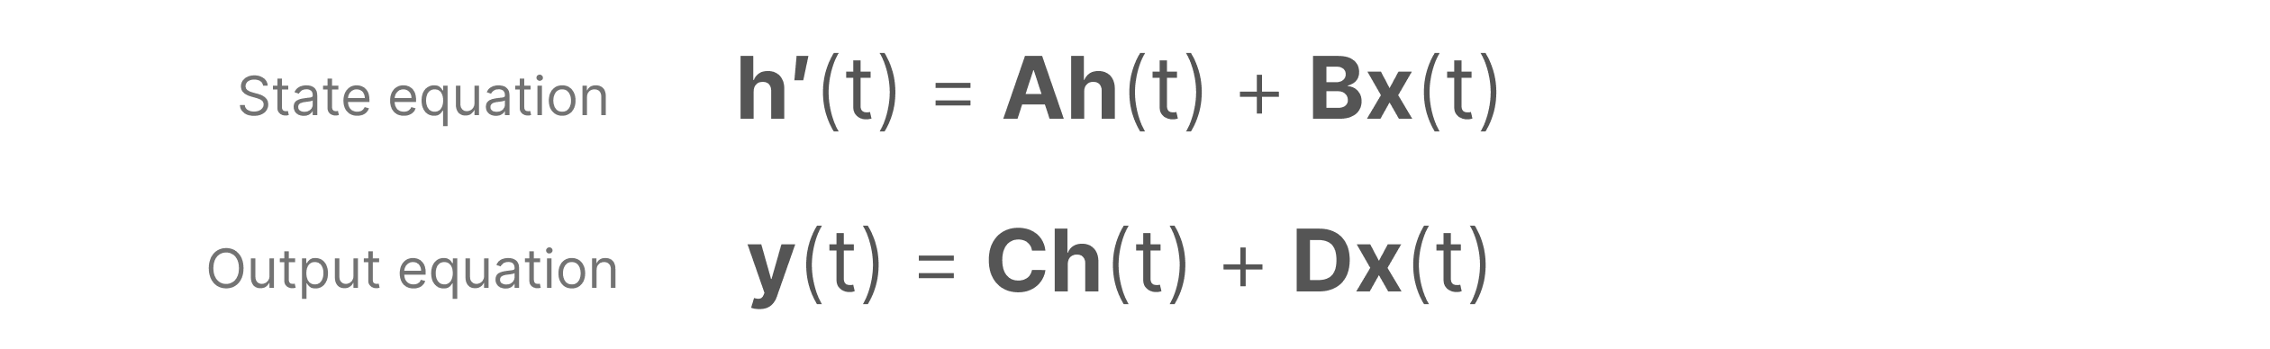
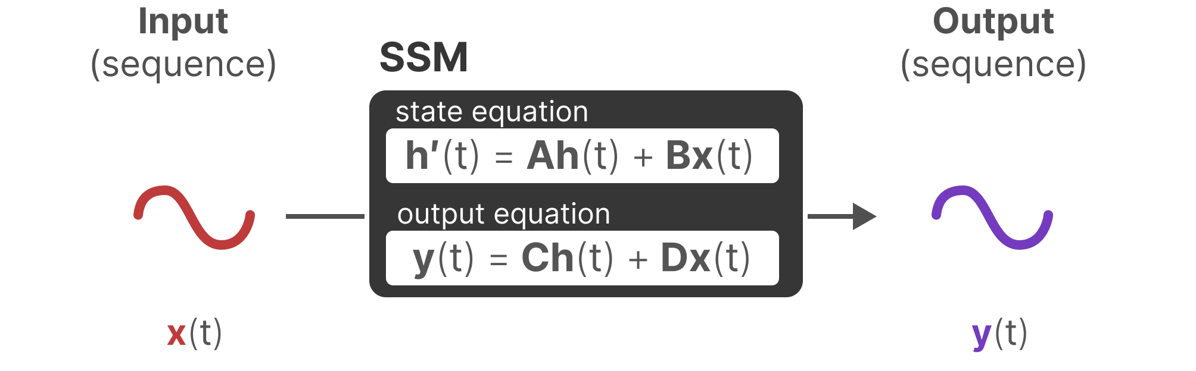
Standard equation in SSM

Slide 12
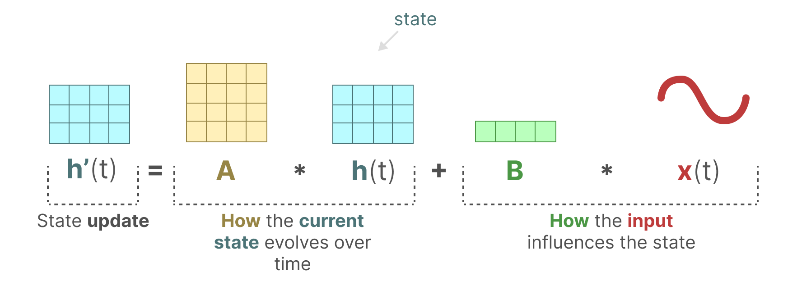
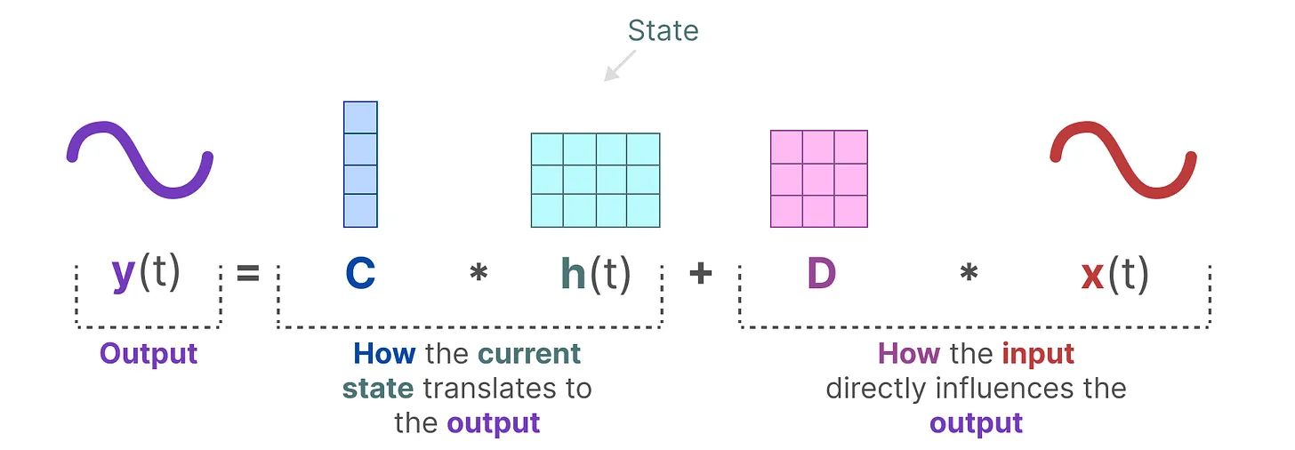

Do you think it is similar to the way you do in the Kalman filter?
Yes, because this method was created by Kalman in 1960.
A New Approach to Linear Filtering and Prediction Problems http://160.78.24.2/Public/Kalman/Kalman1960.pdf

Slide 13
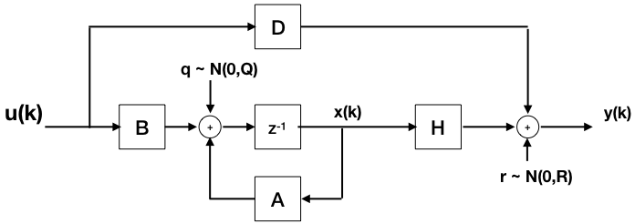
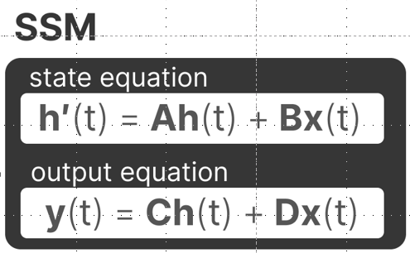
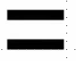
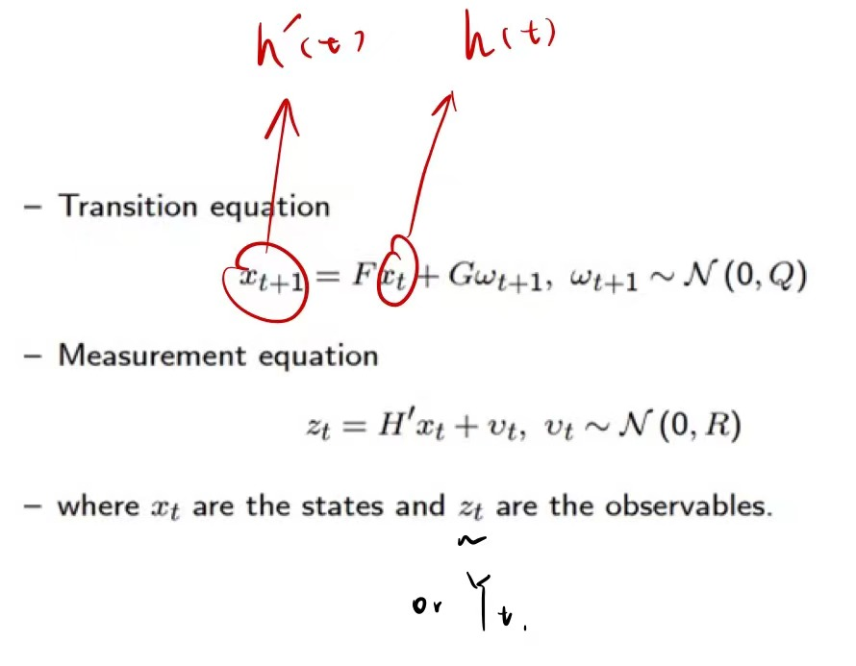
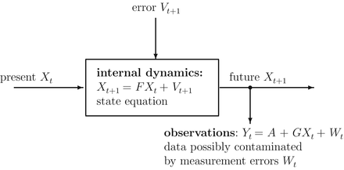
Kalman Filter using SSM

Slide 14
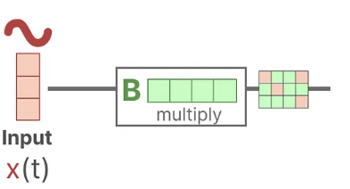
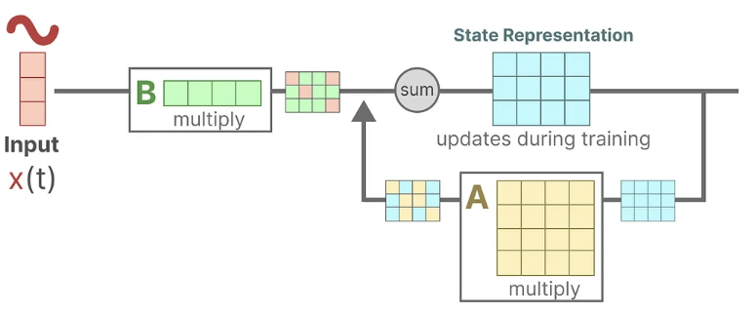
More detail about SSM
Assume we have some input signal x(t), this signal first gets multiplied by matrix B which describes how the inputs influence the system.
The updated state (akin to the hidden state of a neural network) is a latent space that contains the core “knowledge” of the environment. We multiply the state with matrix A which describes how all the internal states are connected as they represent the underlying dynamics of the system.

Slide 15
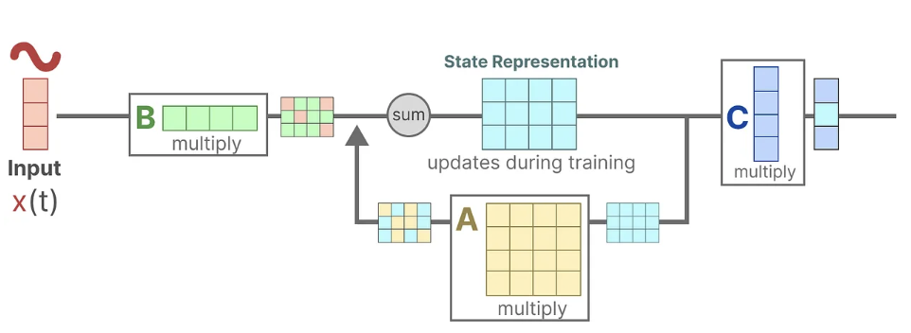
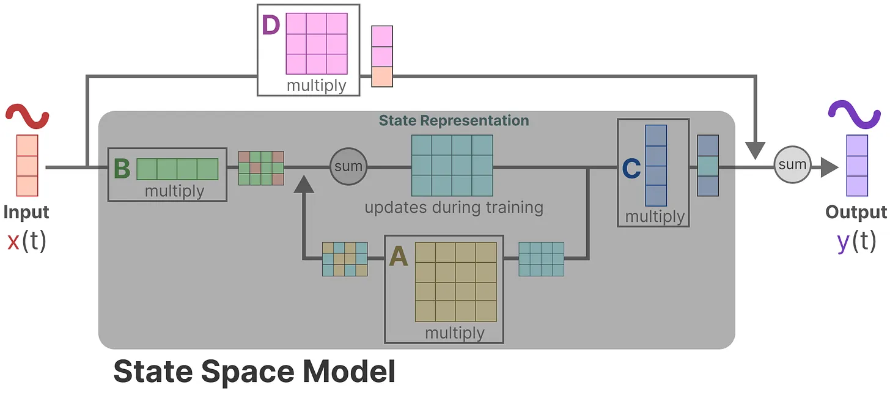
Then, we use matrix C to describe how the state can be translated to an output.
Finally, we can make use of matrix D to provide a direct signal from the input to the output. This is also often referred to as a skip-connection. The SSM is often regarded as the following without the skip-connection.

Slide 16

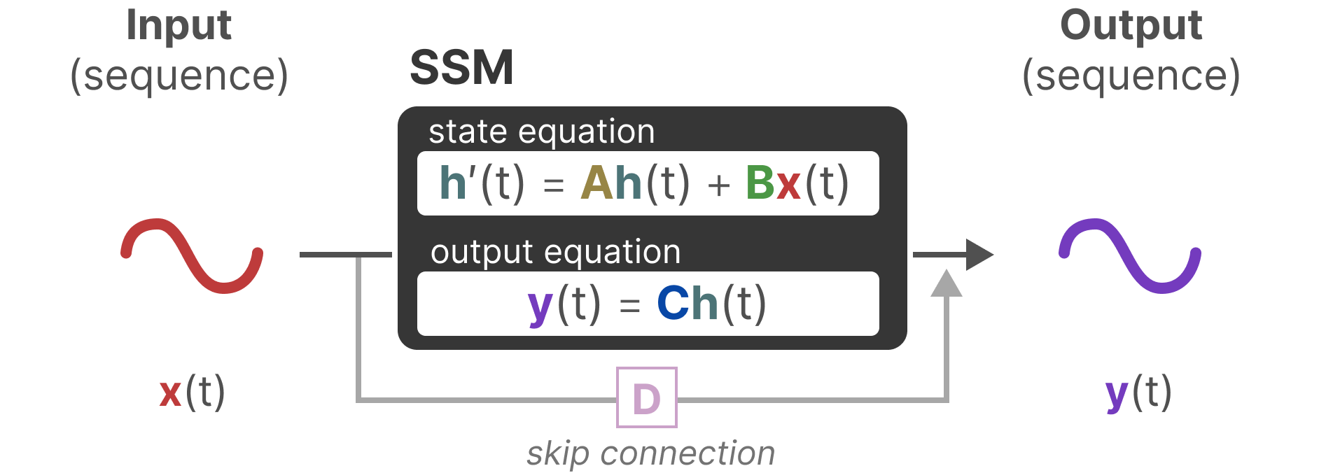
We can now focus on matrices A, B, and C as the core of the SSM.

Slide 17
Discretization
As a continuous-time system, SSM is difficult to directly integrate into Deep Learning model:
Calculation Efficiency: Modern deep learning frameworks and hardware are usually designed based on discrete-time operations. Only after discretizing SSM can it be transformed into a model that can run efficiently on these frameworks and hardware.
Training Algorithms: Most deep learning training algorithms, such as gradient descent and backpropagation, are designed for discrete-time models. Discretization allows these algorithms to be directly applied to state-space models.
Practical Applications: In many practical applications, data is discrete, such as text data (word sequences), time series data (stock prices, sensor readings), etc. Discrete-time models match these data formats more naturally.
Model Complexity: The discretization process can control the complexity of the model by selecting an appropriate time step size T.

Slide 18
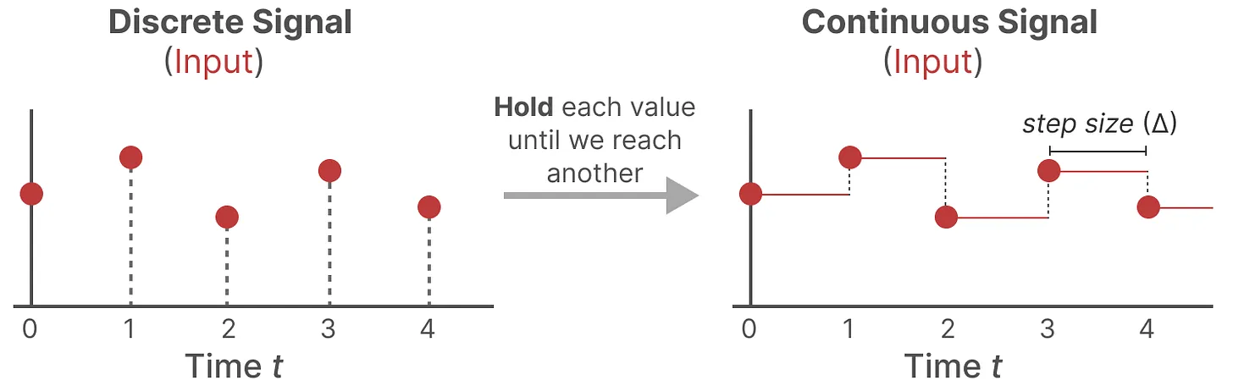
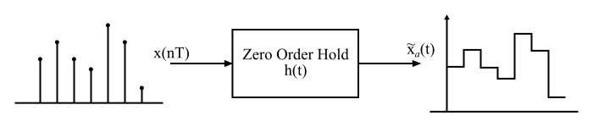
Zero-order hold
In the zero-order hold reconstruction method, the continuous signal is reconstructed from its samples by holding the given sample for an interval until the next sample is received.

Slide 19
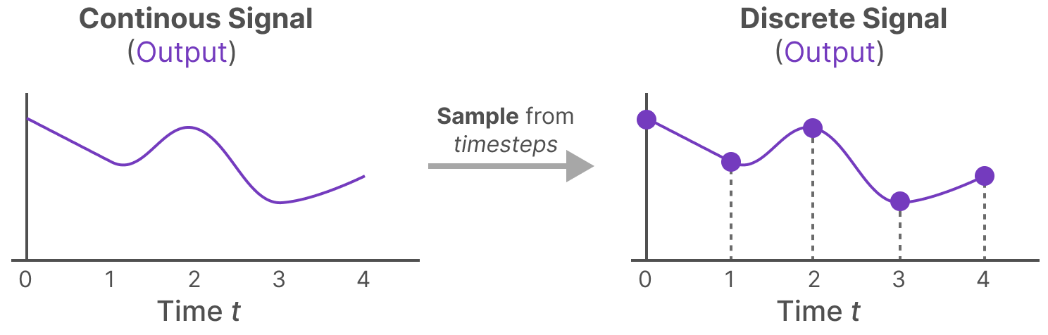
How long we hold the value is represented by a new learnable parameter, called the step size ∆. It represents the resolution of the input.
If we have a continuous signal for our input, we can generate a continuous output and only sample the values according to the time steps of the input.

Slide 20
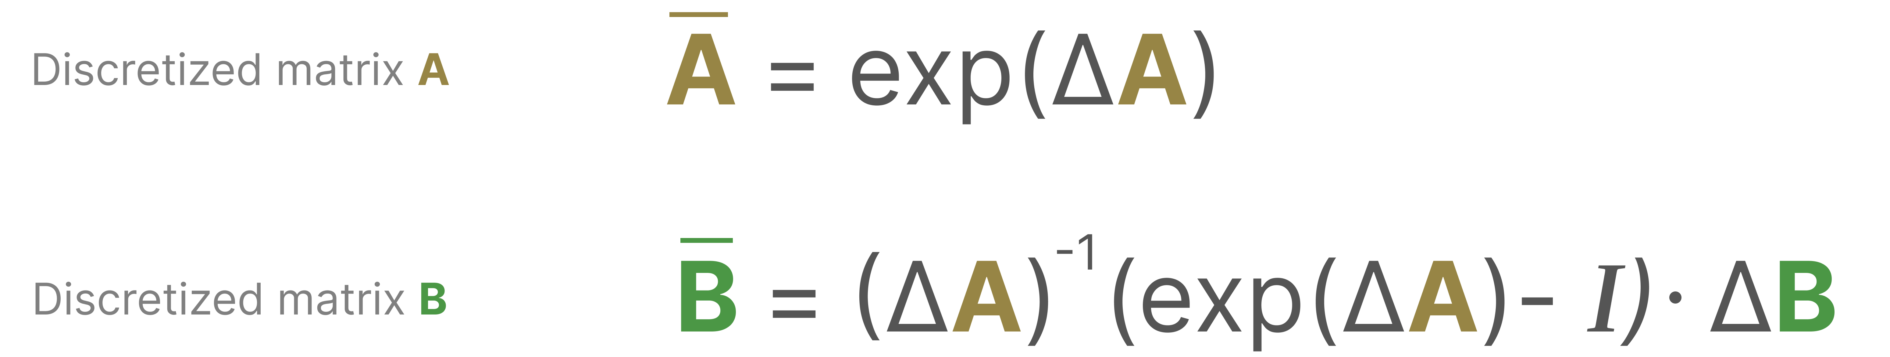
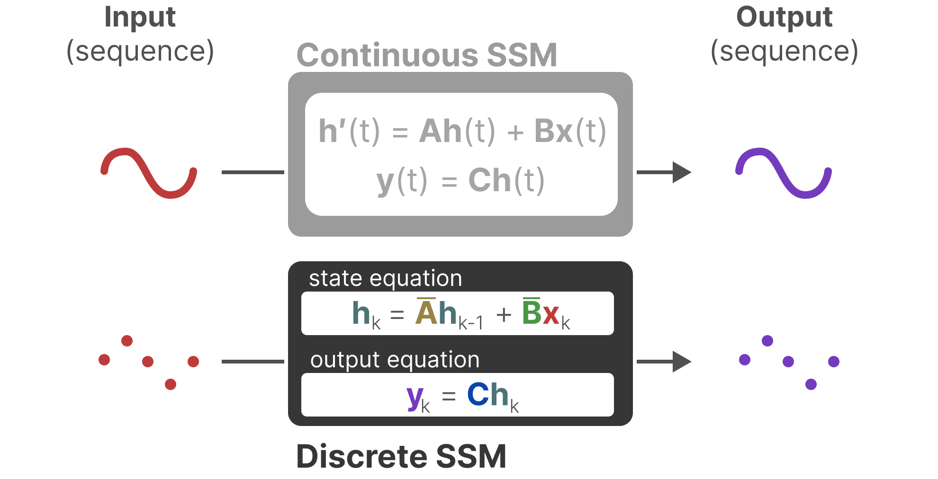
Mathematically, we can apply the Zero-order hold as follows:

Slide 21
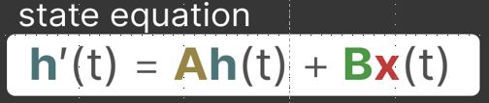
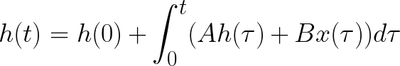
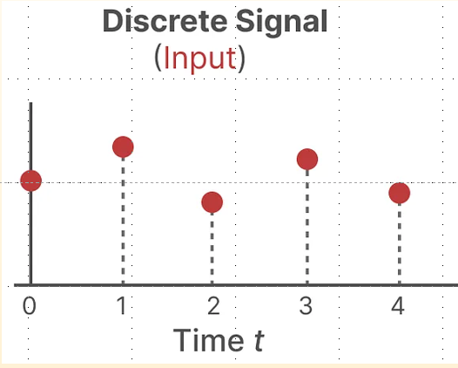
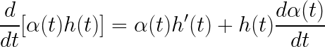
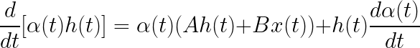
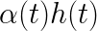
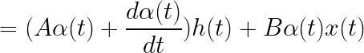
Formula Derivation
To eliminate h(τ) in the integral, we often consider a new function α(t) h(t), and by differentiating this new function, we can express the original integral term.

Slide 22
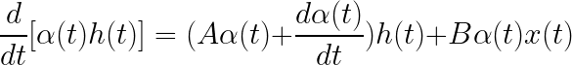
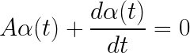
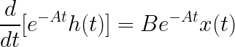
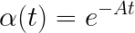
Since our goal is to eliminate the integral involving h(t), we choose α(t) as follows:
Substituting α(t) into the origin equation
Detail step we already derivate in 3D Rotation.
we have completed the auxiliary term for h(t) and α(t)

Slide 23
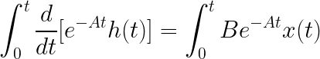
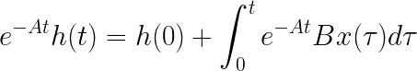
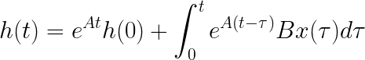

Slide 24
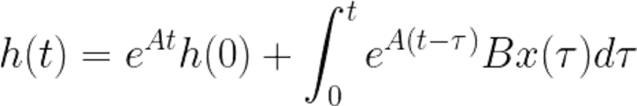
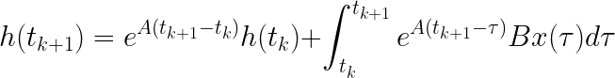
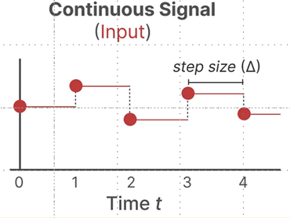
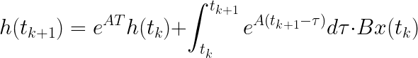
In the discrete system, we need to discretize equation
We set T = t_{k+1} - t_k.
We pick an interval from t to t + Δt. Over the discrete time interval, we divide this interval into N smaller time intervals, each of the lengths T.
Here we use Zero-order hold method, we can assume that \( x(t) \) is constant between the sampling instants \( t_k \) and \( t_{k+1} \), and we can remove it from the integral.

Slide 25
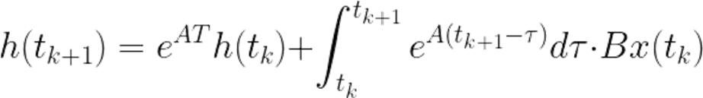
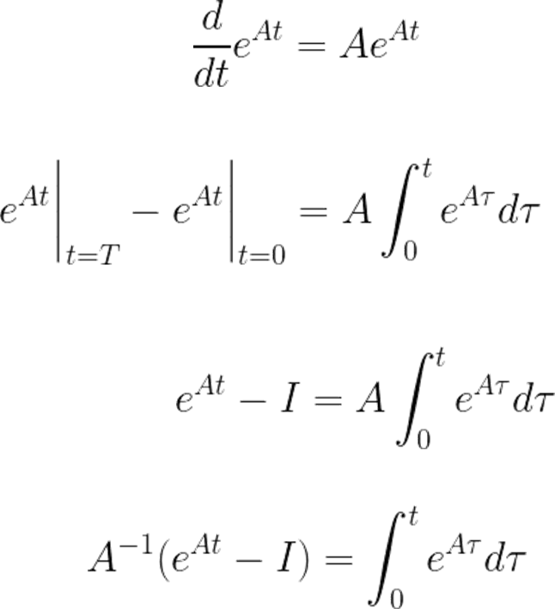
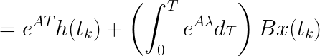


Slide 26


Three Representation

Slide 27






The Recurrent Representation

Slide 28


The Convolution Representation
Another representation that we can use for SSMs is that of convolutions. In classic image recognition tasks, we applied filters (kernels) to derive aggregate features:
Since we are dealing with text and not images, we need a 1-dimensional perspective instead:

Slide 29


The kernel that we use to represent this “filter” is derived from the SSM formulation:

Slide 30






Slide 31

Summary
Since we have the recurrent way and convolutional way, we can choose a way that fits our mission when doing.

Slide 32

But here is another question, we just focus on the current three tokens, how can I have a longer memory?

Slide 33
HiPPO and S4

Slide 34


The solution to the Long-Range Dependency problem——HiPPO
Arguably one of the most important aspects of the SSM formulation is matrix A. As we saw before with the recurrent representation, it captures information about the previous state to build the new state.
Matrix A produces the hidden state:

Slide 35



HiPPO Framework (High-Order Polynomial Projection Operator)
HiPPO attempts to compress all input signals it has seen thus far into a vector of coefficients. Early signal information may experience greater degradation over time, while the latest steps will only experience smaller degradation.
coefficients evolve through time (red, blue) according to a linear dynamical system.
HiPPO Matrix does this by keeping track of the coefficients of a Legendre polynomial.
HiPPO: Recurrent Memory with Optimal Polynomial Projections
https://arxiv.org/abs/2008.07669

Slide 36


Why track the coefficients of a Legendre polynomial?
Legendre polynomials are a set of orthogonal polynomials defined on the interval [−1,1].
HiPPO mainly uses orthogonal polynomials to compress and represent time series data.
The Legendre polynomials P_n(x) are defined as follows:
P_0(x) = 1
P_1(x) = x
P_2(x) = 1/2(3x^2 - 1)
...

Slide 37


Orthogonal Function
In Vector, If A·B = 0, then A and B are Orthogonal.
In n-dimensional space, if there is a vector P that is orthogonal to (n-1) of n pairwise orthogonal vectors, P must be linearly related to the remaining one vector.
Function can be seen as the combination of infinite small vectors.
If the real function f(x) is defined on the interval [a, b], and Δx is sufficiently small, we can get vector F.

Slide 38


f(x) can be represented by a linear combination of the M numbers of M-dimensional vectors that are orthogonal to each other.
Because they are orthogonal to each other, we can pick two from them, let m!=n

Slide 39


Multiply both sides of the equation by Δx
Integral all of them
Next, we will talk about why it is easy to get the coefficient.

Slide 40


f(x) should be equal to the linear combination of M (infinity) number of M-dimensional orthogonal function sets.
Multiply both sides of the equation by g_n(x)

Slide 41

The red line represents the curve we are approximating, while the black bars represent the values of our hidden state. Each is a coefficient for one element of the Legendre series shown as blue functions. The intuition is that the HiPPO matrix updates these coefficients at each step.

Slide 42



Summary
1. Constructing Projections
2. Coefficient Calculation

Slide 43



Back to HiPPO Matrix

Slide 44







Rodrigues‘ formula provides an explicit construction method for Legendre polynomials. For the n-th order Legendre polynomial P_n(x), Rodrigues’ formula is given by:

Slide 45

Summary

Slide 46


Efficiently Modeling Long Sequences with Structured State Spaces
https://arxiv.org/abs/2111.00396

Slide 47
Selective SSM
（Mamba motivation）

Slide 48

Why do we need a selective SSM?
Without selectivity, S4 would spend the same "effort" processing each word

Slide 49

But if it were a model trying to classify the intent of this sentence, it might want to focus more on "order, hamburger" rather than "want, to"

Slide 50
Mamba’s three main contributions:
1. A selective scan algorithm, which allows the model to filter (ir)relevant information.
2. A hardware-aware algorithm that allows for efficient storage of (intermediate) results through parallel scan, kernel fusion, and recomputation.
3. A Simple framework compared to S4, it combines the design of prior SSM architectures with the MLP block of Transformers into a single block.

Slide 51

1. Selectively Retain Information
The recurrent representation of an SSM creates a small state that is quite efficient as it compresses the entire history. However, compared to a Transformer model which does no compression of the history (through the attention matrix), it is much less powerful.
Mamba aims to have the best of both worlds. A small state that is as powerful as the state of a Transformer:

Slide 52


Slide 53


Input and Output
In S4 Model, it was like the Transformer
Batch Size (B) - This dimension represents the number of independent sequences being processed simultaneously. Batch processing efficiently utilizes GPU parallel computing capabilities to speed up the training process.
Sequence Length (L) - This dimension indicates the number of elements (usually words, characters, or time points) in each sequence.
Feature or Embedding Dimension (D) - This dimension represents the number of features for each sequence element.

Slide 54



Difference between S4 and S6(Mamba)
Mamba makes matrices B and C, and even the step size ∆, dependent on the input by incorporating the sequence length and batch size of the input:

Slide 55



SoftPlus is a smooth approximation to the ReLU function and can be used to constrain the output of a machine to always be positive.

Slide 56


A smaller step size ∆ results in ignoring specific words and instead using the previous context more whilst a larger step size ∆ focuses on the input words more than the context.
∆ in SSMs can be seen to play a generalized role of the RNN gating mechanism.
Although we didn’t do anything on A, in the Discretization step, the Aˉ is converted to data dependent.

Slide 57

2. The Scan Operation
Since these matrices are now dynamic, they cannot be calculated using the convolution representation since it assumes a fixed kernel. We can only use the recurrent representation and lose the parallelization the convolution provides.
Each state is the sum of the previous state (multiplied by A) plus the current input (multiplied by B). This is called a scan operation and can easily be calculated with a for loop.

Slide 58



Parallel Scan

Slide 59


Blelloch Algorithm
Up-Sweep
Down-Sweep
https://developer.nvidia.com/gpugems/gpugems3/part-vi-gpu-computing/chapter-39-parallel-prefix-sum-scan-cuda

Slide 60

Example:

Slide 61

3. Flash Attention

Slide 62



Background: GPU Compute Model & Memory Hierarchy
Compute units: do computations, like matrix multiplying and adding things.
SRAM: like cache. It is close to Compute Units so faster than HBM, but has less memory.
High band memory
(GPU memory)

Slide 63


Slide 64


Slide 65


Slide 66


Slide 67


Slide 68

FlashAttention: Fast and Memory-Efficient Exact Attention with IO-Awareness
https://arxiv.org/abs/2205.14135

Slide 69


Slide 70


Mamba, like Flash Attention, attempts to limit the number of times we need to go from DRAM to SRAM and vice versa. It does so through kernel fusion which allows the model to prevent writing intermediate results and continuously performing computations until it is done.

Slide 71


Slide 72

Finally

Slide 73


Slide 74
Reference
Gu, A., & Dao, T. (2023, December 1). Mamba: Linear-time sequence modeling with selective state spaces. arXiv.org. https://arxiv.org/abs/2312.00752
Grootendorst, M. (2024, February 19). A visual guide to Mamba and state space models. https://newsletter.maartengrootendorst.com/p/a-visual-guide-to-mamba-and-state
State space models and filtering - penn arts & sciences. (n.d.). https://www.sas.upenn.edu/~jesusfv/LectureNotes_9_filtering.pdf
Srush. (n.d.-b). Annotated-S4. GitHub. https://srush.github.io/annotated-s4/

